Slide 1
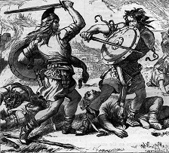
Answering Did Islam Spread by the Sword?

Slide 2
The Quran Says No.
The following verses from the Quran forbid imposing the religion on people.
Quran 2:256 [There is no compulsion in religion].
Quran 50:45 [Can’t force them to believe].
Quran 10:99 [Your Lord could have made all people on earth believe. Who are you (Mohamed) to compel them against the will of God].

Slide 3
Islamic Law (Sharia) Says
Any declarations, consent, marriage, divorce, contractual agreement, decision, testimony imposed by force is invalid.

Slide 4
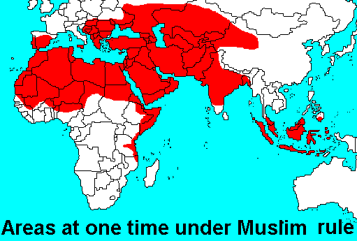
The Job of the Sword
The sword opens a land and doesn’t open a heart. In other words, the sword has been used to expand the empire not to expand the religion.

Slide 5
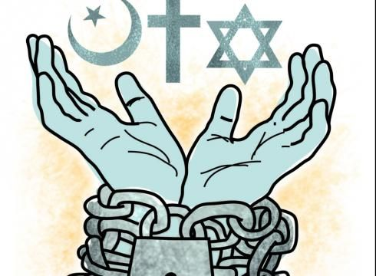
Force cannot be Used to Compel Religion
Using force to compel religion produces nothing but hypocrisy. The one who is under the threat of the sword will not love or practice Islam nor will teach it to his/her children.

Slide 6
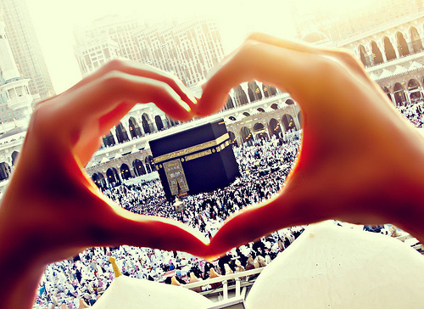
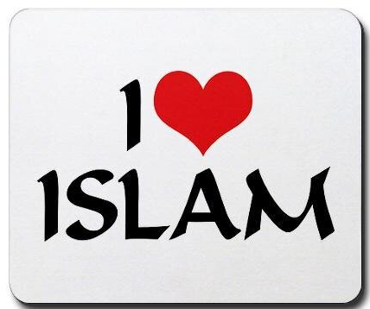
Must Love Islam
The person who loves and practice Islam, as well as teach Islam to his children, is not the one under the threat of the sword.

Slide 7
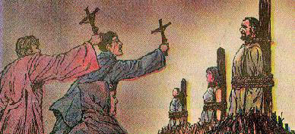
No Inquisition
Unlike the history of Christianity that has 400 years of inquisition; the history of Islam doesn’t have any form of inquisition.

Slide 8
The Example of Indonesia
The largest population of Muslims in the entire world is Indonesia. Islam came to it without any military interaction. It was because Muslim merchants came in the country to do business.

Slide 9
Difference between Invasion and Occupation
The difference between occupation and liberation is that occupation makes the invaded country worse than it was while libration makes it better than it was. Muslims made the invaded countries better than it was, even better than their own home land. An example of this fact is Spain. Click here to see how Muslims made Spain better than the homeland they came from.

Slide 10
Difference between Invasion and Occupation (Continue)
The British occupied Egypt for 80 years and did not make Cairo better than London.
The French occupied Algeria for 140 years and they did not make Algeria better than Paris.
George Bush invaded Iraq and did not make it better than Washington D.C. He made it much worse than it was at the time of Sadam.

Slide 11
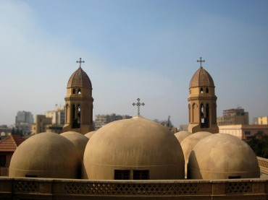
Muslims Protected and Respected Worship Places for Other Faiths
Very old churches in Egypt has been protected by the Islamic States

Slide 12
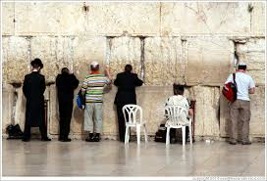
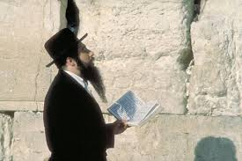
Muslims Protected and Respected Worship Places for Other Faiths (Continue)
Church of Nativity in Bethlehem
where Jesus was born still exist and
respected to date in Palestine.
Crying Wall for Jews still exist and has been respected by the Islamic
State in Palestine.

Slide 13
Islam has been Protecting Minorities
Muslim states had many Minorities that have been Living Safely for Hundreds of Years and their Places of Worship have been Protected by the Islamic state.
Justice for All

Slide 14
Islamic Law (Sharia) Protects Minorities
People of the Book
The Islamic Law (Sharia) has a well established law that protects the rights of people of other faith that live in a Muslim state. The Christians and the Jews are called the people of the book in the Islamic Law. In addition, Other non Muslims are called the people of Dhima in the Islamic Law.

Slide 15
Islam Allows Muslim Men to Marry from the People of the Book
Islam allows a Muslim man to have a wife who is Christian or Jewish Quran 5:5. This is the highest level of tolerance when the most beloved person to your heart and the mother of your children is from a different religion.

Slide 16
Islam allows Muslims to have Relationships with Non Muslims Who are not Fighting against the Religion of Islam
Quran 60:8 & 9. It basically says that God doesn’t mind if you have non Muslim Friends and loved ones but he doesn’t want you to have relationships with enemies of the Religion.

Slide 17
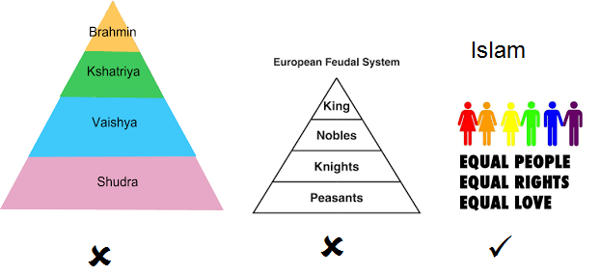
Why did People in Conquered Land Embrace Islam
The reason people entered Islam after the Muslims used the sword to open the land was because they saw the difference between the old government and the new government. They have seen what Islam brought them and they liked it.

Slide 18
What Happens to the Muslims who Denounce Islam Publicly.
Islam has a policy that says if you don’t harm the religion, the religion will not harm you.
At the time of the Prophet, enemies of Islam used to embrace Islam in the morning and then denounce it in the evening announcing publicly that Islam is a bad religion. It was a tactic to drive people away from Islam. The Quran mentions this fact Quran 3:72.
To stop people from doing this, the Prophet order that the ones who embrace Islam and then denounce it publicly be given three days chance to correct themselves publicly or get killed.
If people denounce Islam privately, nothing happens to them.
During the three days all what the person has to do is to declare publicly that he was wrong and then he/she will let go. It is an easy way out.
This rule applies only in Muslim countries.

