Slide 1
Great Sayings about Prophet Mohamed saw
http://answers.islammercy.net/
Answers@IslamMercy.net

Slide 2
What is the fact ?
Cartoonists caricature him mean
Wise men adore him a great man
Billion* bear witness him a Messenger of God
*1,126,325,000

Slide 3
YOU SHOULD KNOW THIS MAN

Slide 4
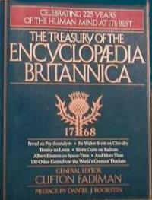
ENCYCLOPAEDIA BRITANNICA confirms:
“.... A mass of detail in the early sources show that he was an honest and
upright man who had gained the respect and loyalty of others who were
like-wise honest and upright men." (Vol. 12)

Slide 5
GEORGE BERNARD SHAW about him:
"If any religion had the chance of ruling over England, nay Europe within the next hundred years, it could be Islam."
I have always held the religion of Muhammad in high estimation because of its wonderful vitality. It is the only religion, which appears to me to possess that assimilating capacity to the changing phase of existence,
which can make itself appeal to every age.
I have studied him - the wonderful man and in my opinion for from being an anti-Christ, he must be called the Savior of Humanity."

Slide 6
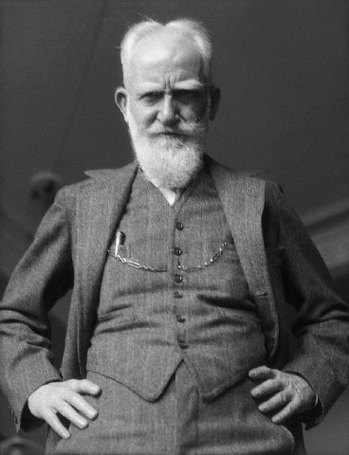
GEORGE BERNARD SHAW about him:
"I believe that if a man like him were to assume the dictatorship of the modern world he would succeed in solving its problems in a way that would bring it the much needed peace and happiness:
I have prophesied about the faith of Muhammad that it would be acceptable to the Europe of tomorrow as
it is beginning to be acceptable to the Europe of today.”
(Sir George Bernard Shaw in 'The Genuine Islam,' Vol. 1, No. 8, 1936.)

Slide 7
He did it…
He was by far the most remarkable man that ever set foot on this earth.
He preached a religion, founded a state, built a nation, laid down a moral code, initiated numerous social and political reforms
He established a powerful and dynamic society to practice and represent his teachings and
completely revolutionized the worlds of human thought and behavior for all times to come.

Slide 8
YES! HE IS MUHAMMED
(May Peace of God Be Upon Him (pbuh)

Slide 9
He was born in Arabia in the year 570, started his mission of preaching the religion of Truth, Islam (submission to One God) at the age of forty and departed from this world at the age of sixty-three.

Slide 10
His Mission
During this short period of 23 years of his Prophet hood, he changed the complete Arabian peninsula
From paganism and idolatry to SUMISSION to The God,
From tribal quarrels and wars to national solidarity and cohesion,
From drunkenness and debauchery to sobriety and piety,
From lawlessness and anarchy to disciplined living,
From utter bankruptcy to the highest standards of moral excellence.
Human history has never known such a complete transformation of a society or a place before or since – and IMAGINE all these unbelievable wonders in JUST OVER TWO DECADES.

Slide 11
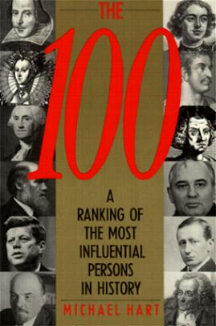
MICHAEL H. HART in his book on Ratings of Men
He ranked Mohammed first in the list, who contributed towards the benefit and uplift of mankind:
"My choice of Muhammad to lead the list of the world's most influential persons may surprise some readers and may be questioned by others, but he was the only man in history who was supremely successful on both the
religious and secular levels."
(M.H. Hart, THE 100: A RANKING OF THE MOST
INFLUENTIAL PERSONS IN HISTORY, New York, 1978, p. 33)

Slide 12
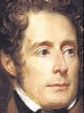
LAMAR TINE, the renowned historian, speaking on the essentials of human greatness wonders:

Slide 13
"If greatness of purpose, smallness of means and astounding results are the
three criteria of human genius, who could dare to compare any great man in
modern history with Muhammad?

Slide 14
La-Martine..
The most famous men created arms, laws and empires only. They founded, if anything at all, no more than material powers which often crumbled away before their eyes.
This man moved not only armies, legislation, empires, peoples and dynasties, but millions of men in one-third of the then inhabited world; and more than that, he moved the altars, the gods, the religions, the ideas, the beliefs and souls....

Slide 15
La Martine..
His forbearance in victory, his ambition, which was entirely devoted to one idea and in no manner striving for an empire;
His endless prayers, his mystic conversations with God, his death and his triumph after death;
All these attest not to an imposture but to a firm conviction which gave him the power to restore a dogma.
This dogma was two-fold, the unity of God and the immateriality of God; the former telling what God is, the latter telling what God is not; the one overthrowing false gods with the sword, the other starting an idea with the words.

Slide 16
(Alphonse de Lamar tine, HISTOIRE DE LA TURQUIE, Paris, 1854, Vol. II, pp 276-277)
"Philosopher, orator, apostle, legislator, warrior, conqueror of ideas, restorer of rational dogmas, of a cult without images,
the founder of twenty terrestrial empires and of one spiritual empire, that is MUHAMMAD.
As regards all the standards by which Human Greatness may be measured, we may well ask,
IS THERE ANY MAN GREATER THAN HE?"

Slide 17
The world has had its share of great personalities. But these were one-sided figures who distinguished themselves in but one or two fields, such as religious thought or military leadership.
The lives and teachings of these great personalities of the world are shrouded in the mist of time.
There is so much speculation about the time and place of their birth, the mode and style of their life, the nature and detail of their teachings and the degree and measure of their success or failure that it is impossible for humanity to reconstruct accurately the lives and teachings of these men.

Slide 18
DIWAN CHAND SHARMA wrote:
"Muhammad was the soul of kindness, and his influence was felt and never
forgotten by those around him." (D.C. Sharma, THE PROPHETS OF THE EAST,
Calcutta, 1935, pp. 12)

Slide 19
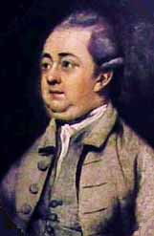
EDWARD GIBBON and SIMON OCKLEY speaking on the profession of ISLAM write:
"'I BELIEVE IN ONE GOD, AND MAHOMET, AN APOSTLE OF GOD' is the simple and invariable profession of Islam. The intellectual image of the Deity has
never been degraded by any visible idol; the honor of the Prophet has never
transgressed the measure of human virtues; and his living precepts have
restrained the gratitude of his disciples within the bounds of reason and
religion." (HISTORY OF THE SARACEN EMPIRES,
London, 1870, p. 54)

Slide 20
He is not God
Muhammad (pbuh) was nothing more or less than a human being. But he was a man with a noble mission, which was to unite humanity on the submission to ONE and ONLY GOD and to teach them the way to ideal and upright living
based on the commands of God.
He always described himself as, 'A Servant
and Messenger of God,' and so indeed every action of his proclaimed to be.

Slide 21
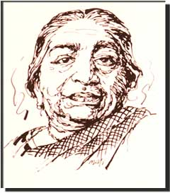
The famous poetess of India, SAROJINI NAIDU says:
"It was the first religion that preached and practiced democracy; for, in the mosque, when the call for prayer is sounded and worshippers are gathered together, the democracy of Islam is embodied five times a day when the peasant and king kneel side by side and proclaim: 'God Alone is Great'...
I have been struck over and over again by this indivisible unity of Islam that makes man instinctively a brother"
(S.Naidu, IDEALS OF ISLAM, vide Speeches & Writings, Madras, 1918, p. 169)

Slide 22
In the words of PROF. HURGRONJE
"The league of nations founded by the prophet of Islam put the principle of international unity and human brotherhood on such universal foundations as to show candle to other nations.“
He continues: "The fact is that no nation
of the world can show a parallel to what Islam has done towards the
realization of the idea of the League of Nations."

Slide 23
The world has not hesitated to raise to divinity, individuals whose lives and missions have been lost in legend. Historically speaking, none of these legends achieved even a fraction of what Muhammad (pbuh) accomplished. And all his striving was for the sole purpose of uniting mankind for the worship of One God on the codes of moral excellence.
Muhammad (pbuh) or his followers never at any time claimed that he was a Son of God or the God-incarnate or a man with divinity - but he always was and is even today considered as only a Messenger chosen by God.

Slide 24
Today after a lapse of fourteen centuries, the life and teachings of MUHAMMAD (pbuh)have survived without the slightest loss, alteration or
interpolation. They offer the same undying hope for treating mankind's many ills, which they did when he was alive.
This is not a claim of Muhammad's (pbuh) followers but also the inescapable conclusion forced upon by a critical and unbiased history.

Slide 25
Not so this man. Muhammad (peace be up on him) accomplished so much in such diverse fields of human thought and behavior in the fullest blaze of human history.
Every detail of his private life and public utterances has been accurately documented and faithfully preserved to our day. The authenticities of the record so preserved are vouched for not only by the faithful followers but
also even by his prejudiced critics.

Slide 26
Muhammad (pbuh) was a teacher, a social reformer, a moral guide, an administrative colossus, a faithful friend, a wonderful companion, a devoted husband, a loving father - all in one.
No other man in history ever excelled or equaled him in any of these different aspects of life - but it was only for the selfless personality of Muhammad (pbuh) to achieve such incredible perfections.

Slide 27
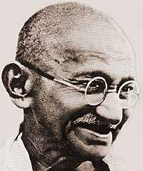
MAHATMA GANDHI
Speaking on the character of Muhammad, (pbuh) says in YOUNG INDIA:
"I wanted to know the best of one who holds today's undisputed sway over the hearts of millions of mankind..
I became more than convinced that it was not the sword that won a place for Islam in those days in the scheme of life.

Slide 28
MAHATMA GANDHI
It was the rigid simplicity, the utter self-effacement of the Prophet, the scrupulous regard for his pledges, his intense devotion to this friends and followers, his intrepidity, his fearlessness, his absolute trust in God and in his own mission. These and not the sword carried everything before them and surmounted every obstacle. When I closed the 2nd volume (of the Prophet's biography), I was sorry there was not more for me to read of the great life."

Slide 29
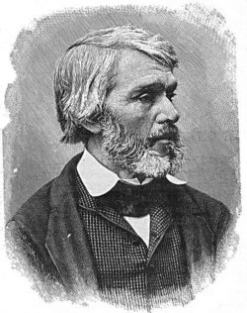
THOMAS CARLYLE in his HEROES AND HEROWORSHIP, was simply amazed as to:
"How one man single-handedly, could weld warring tribes and wandering Bedouins into a most powerful and civilized nation in less than two
decades."
"The lies (Western slander) which well-meaning zeal has heaped round this man (Muhammad) are disgraceful to ourselves only."
"A silent great soul, one of that who cannot but be earnest. He was to kindle the world, the world’s Maker had ordered so."

Slide 30
Now please relax for a moment
The least YOU could do as thinking and concerned human being is to stop for
a moment and ask yourself: Could these statements sounding so extraordinary
and revolutionary be really true?

Slide 31
And supposing they really are true and
you did not know this man MUHAMMAD (pbuh)or hear about him, isn't it time
you responded to this tremendous challenge and put in some effort to know
him?

Slide 32
Dear,
It will cost you nothing but it may prove to be the beginning of a
completely new era in your life.

Slide 33
Thank you for the time
Any queries? please don’t hesitate to contact
http://answers.islammercy.net/
Answers@IslamMercy.net

